Slide 1
Advance Application Programming in Python
Project Title - Resume Builder
Vinay Rao Kalakuntla - 700756963
Gopinadh Karlapudi - 700763819
Vandana Cherukuri - 700759337
Meghana - 700757710

Slide 2
What? Why? How?
What?
This project is a resume builder web application
Why?
The purpose of this project is to provide users with an easy-to-use platform for creating, editing, and managing their resumes.
How?
The primary purpose of this resume builder project is to address the common challenges individuals face when creating and managing their resumes.

Slide 3
Abstract
Resume Bulider is a Web Application Generates a Professional Resume.
This Tool Offers a User Friendly and Simple Way to take User Input their Name, Personal Details, Professional Work Experience, Educational Background and Skills and other Key Information .
This Information is used to Generate Formatted Resume in Various Styles and We Can Select the Format and Style Which is Best Suitable and Download it into your Desktop.

Slide 4
Introduction
In today's competitive job market, a well-crafted resume is essential for individuals to effectively showcase their qualifications and secure employment opportunities.
To address these challenges, we have developed a resume builder application that streamlines the process of resume creation, making it accessible and efficient for users of all skill levels.
This resume builder uses modern web technologies to create a robust and user-friendly platform.
The backend is built with Python Flask, a web framework that makes developing web applications straightforward.

Slide 5
Introduction
Flask handles important tasks like user authentication, data processing, and communication with the database.
For storing data, the application uses, SQLITE database, ensuring user data is securely stored and easily accessible.
The frontend of the application is developed using Python, HTML, and CSS, JavaScript providing a responsive and interactive user interface. This allows users to create, edit, and format their resumes in real-time, with helpful templates and guidelines to ensure a polished and professional result.
By combining these technologies, the resume builder application makes the resume creation process simpler and helps users effectively present their qualifications and experiences.

Slide 6
Technologies Used
Python
Flask
SQLITE
HTML
CSS
JavaScript

Slide 7
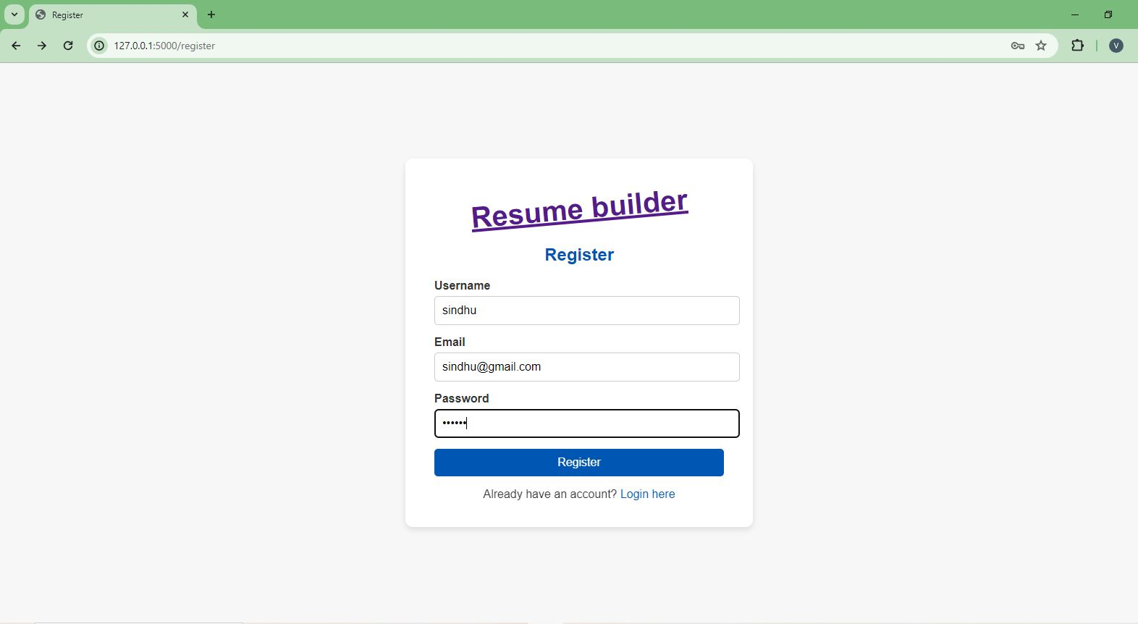
Implementation
1. Register to the Application

Slide 8
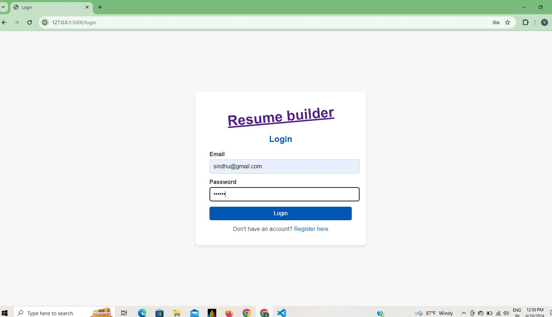
Implementation
2. Login to the web Application

Slide 9
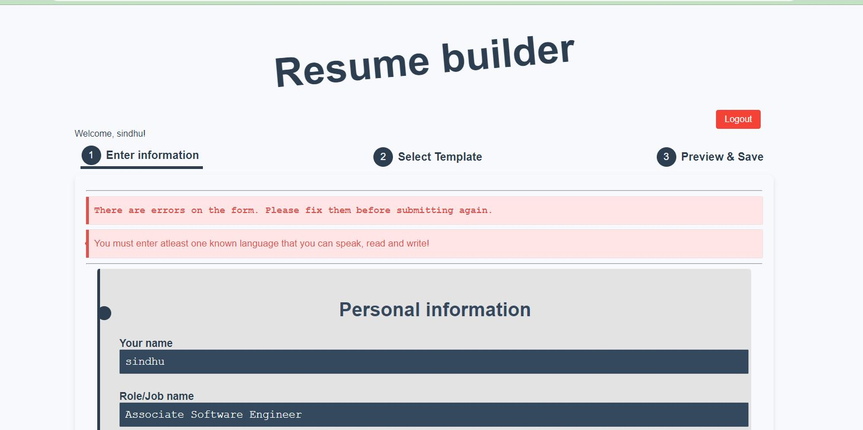
Implementation
3. Home page will appear as follows which contain welcome message, enter information, select template and preview and save option

Slide 10
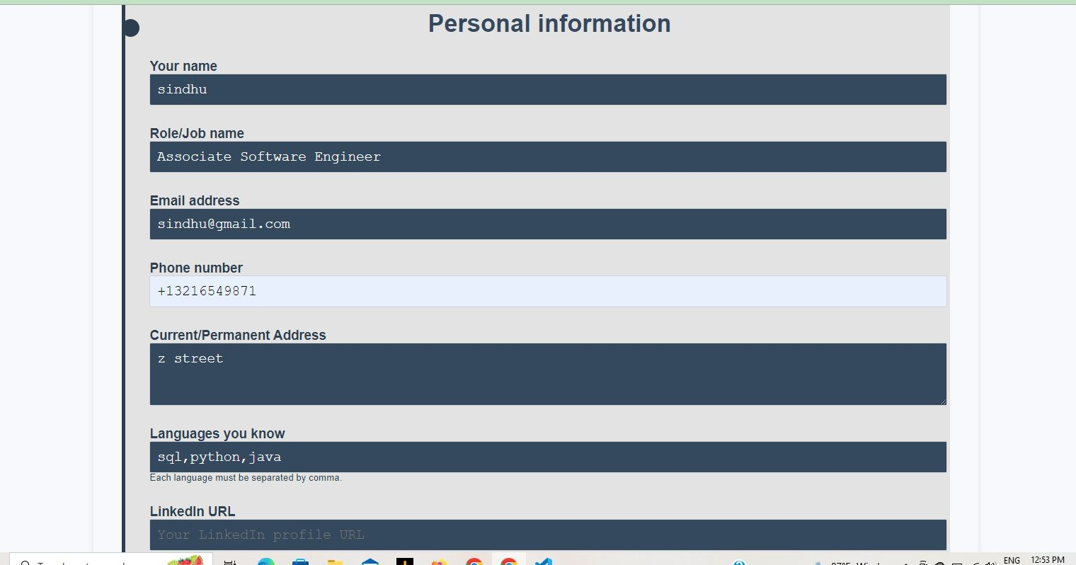
Implementation
4. Enter the required details

Slide 11
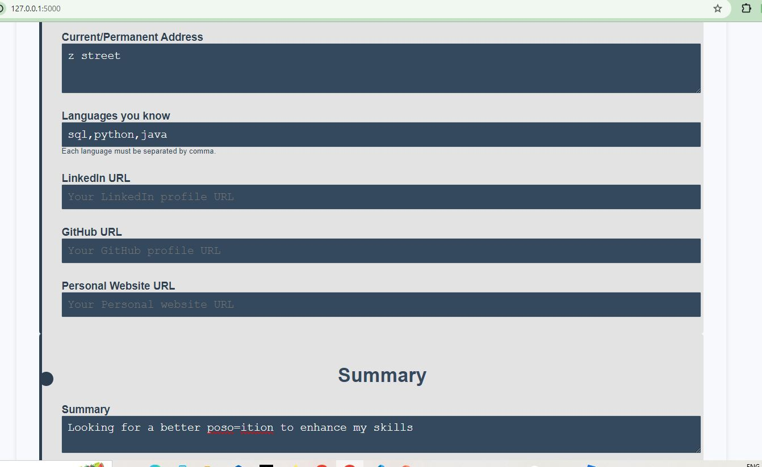
Implementation
4. Enter the required details

Slide 12
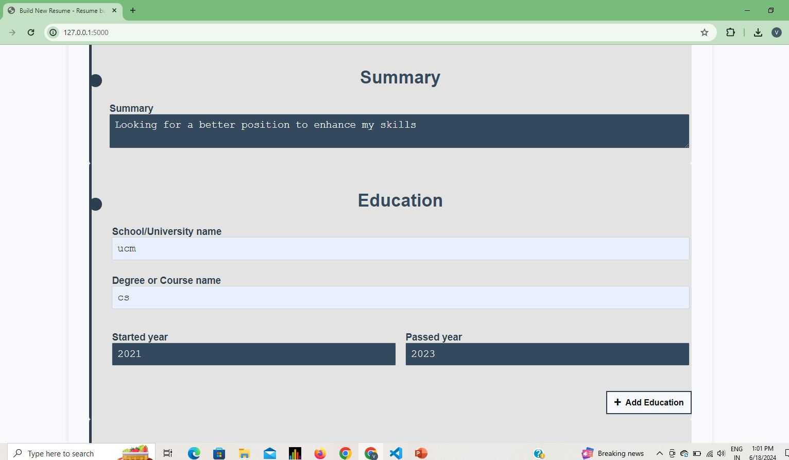
Implementation
4. Enter the required details

Slide 13
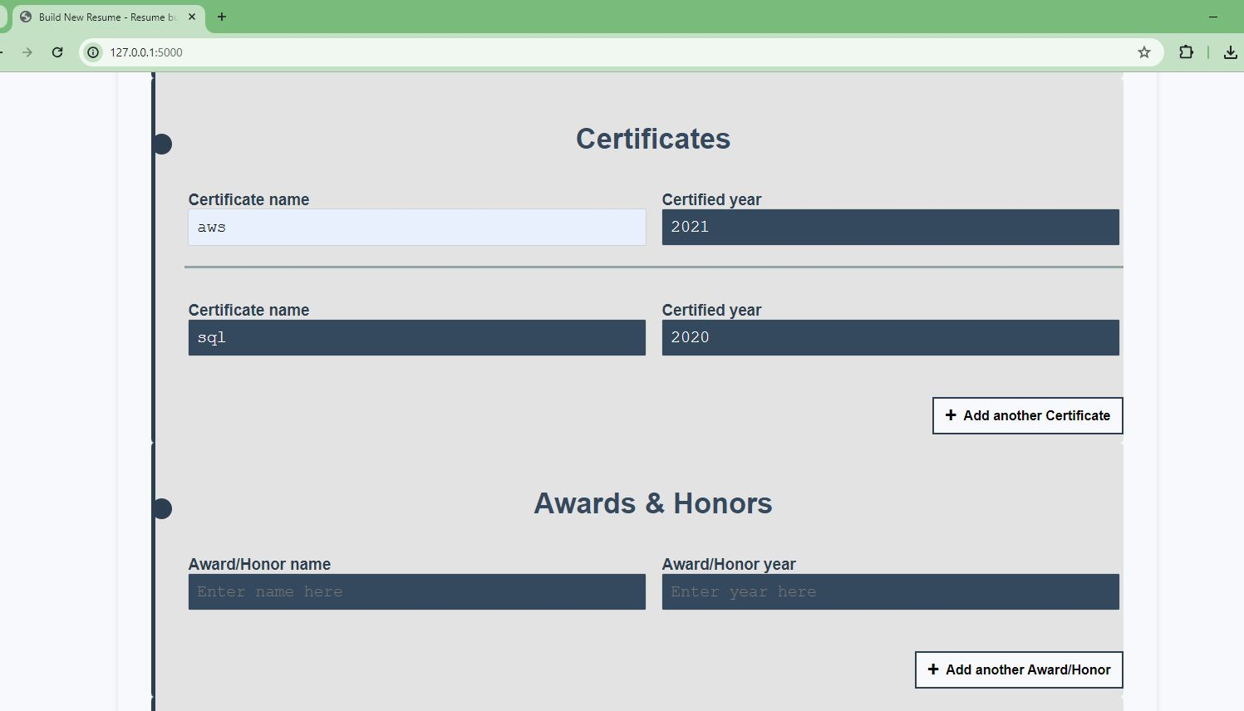
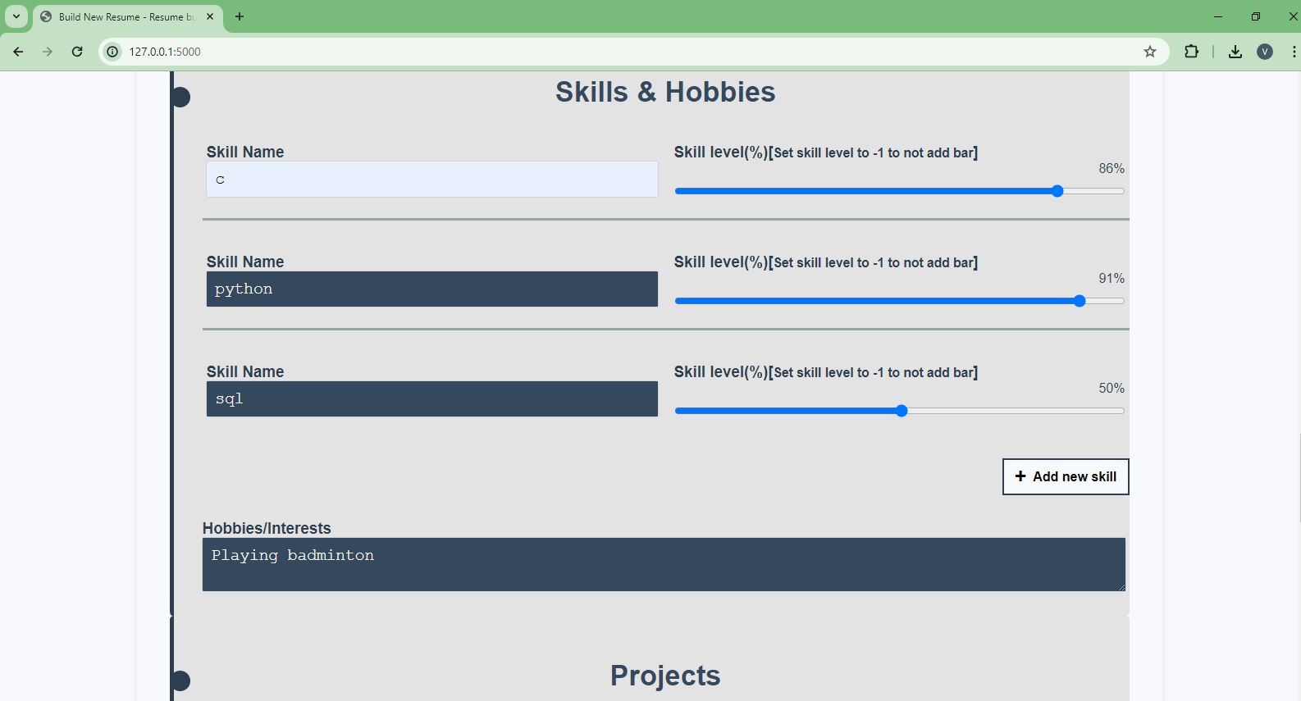
Implementation
4. Enter the required details

Slide 14
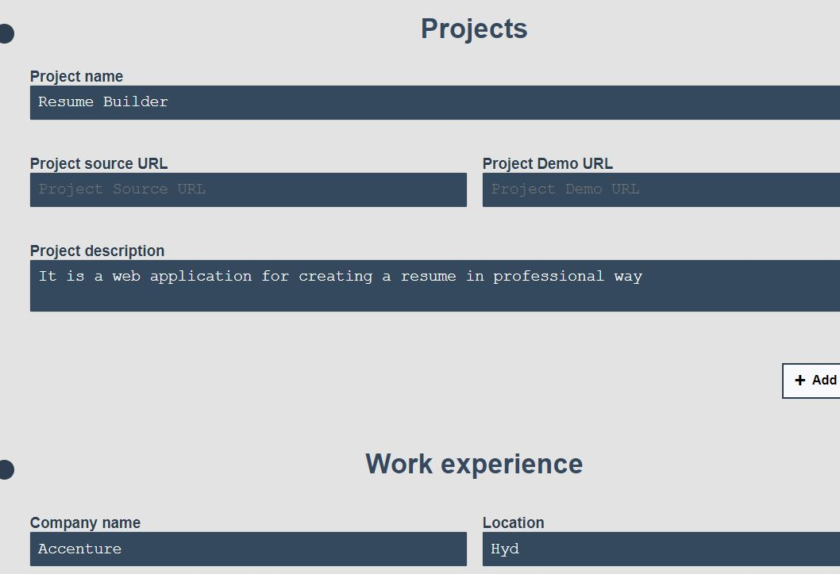
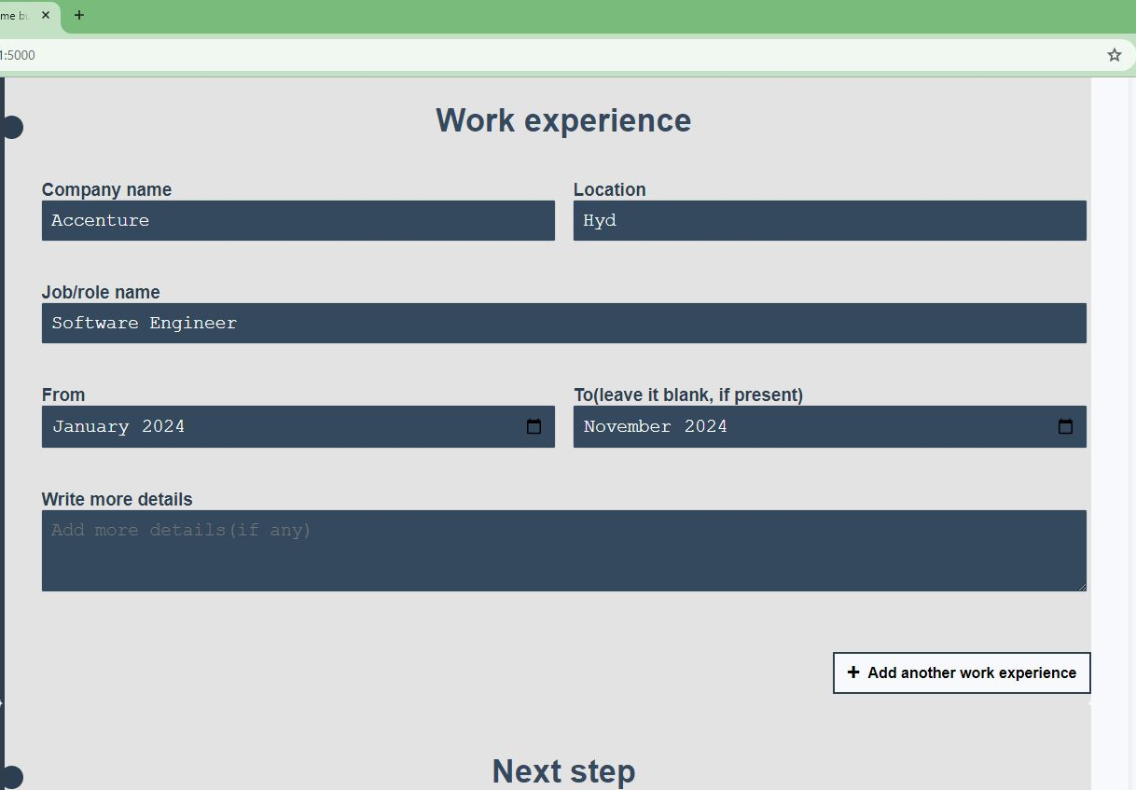
Implementation
4. Enter the required details

Slide 15
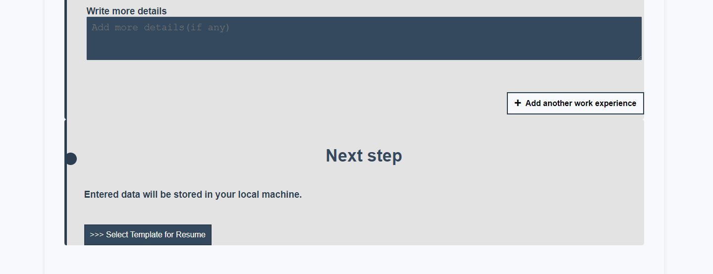
Implementation
5. Move to select template for Resume

Slide 16
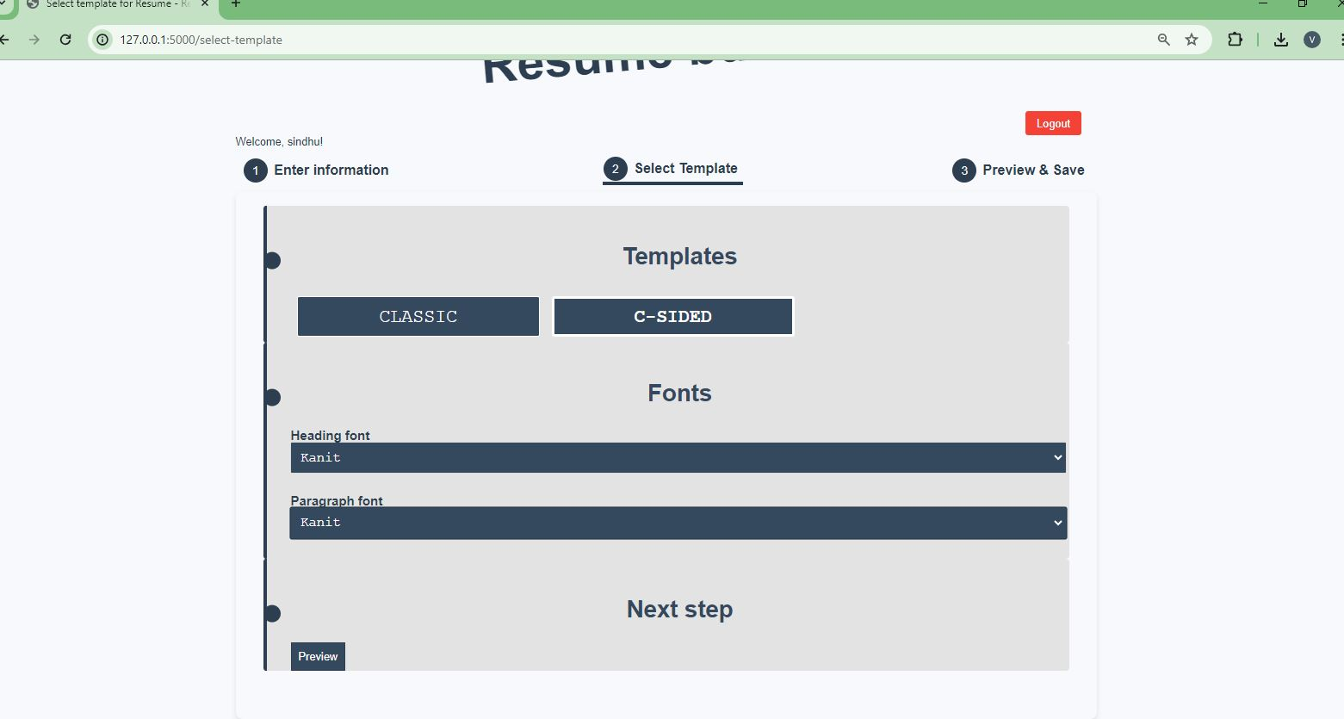
Implementation
6. Select for Resume templates and Fonts(heading and paragraph)

Slide 17
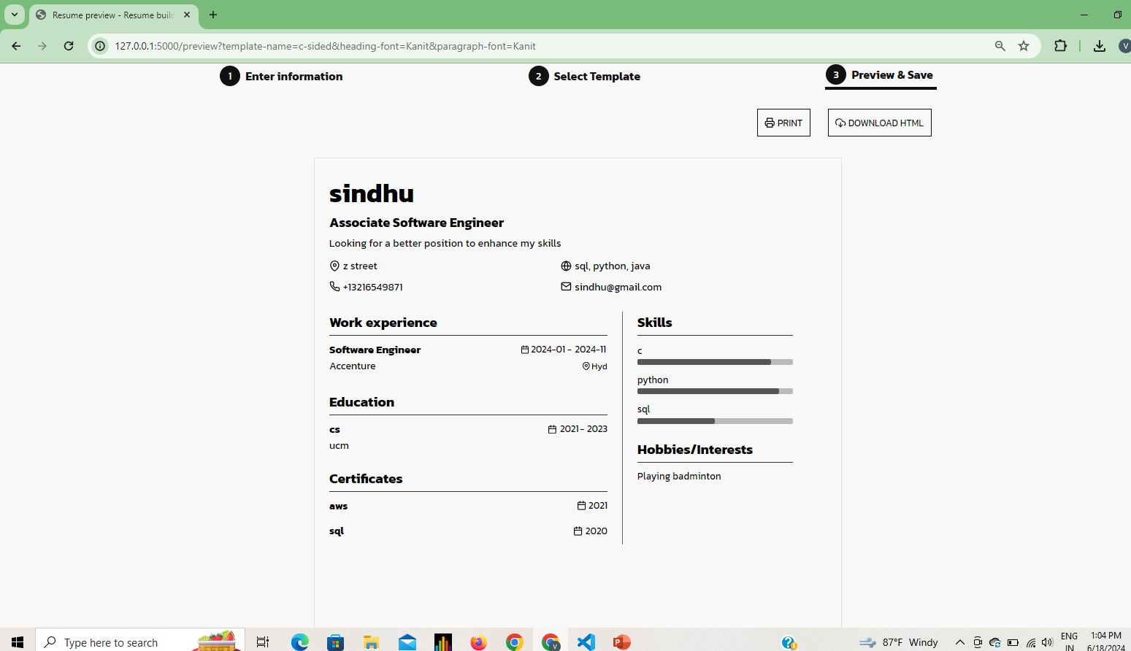
Implementation
7. Preview and save(download) in html format

Slide 18
Thank you
Team – Resume Builder

